Slide 1



Help & Hope Project

Slide 2
Presentation content:
(5 minutes)
Problem statement
Brief about the project
Wireframe
Demo of the project
Technologies used
What was the most difficult part of the project
What was your favorite part of the project
What are the new things you learned creating this application
(5 minutes )
Display and walk through the project
Walk through a piece of code
(5 minutes )
QA from instructors and classmates

Slide 3
Problem statement​ & Brief about the project
Social Network for Mental Health This global pandemic has affected almost everyone's mental health in some way or form. Creating a safe place where people can talk about it and share stories would be great. It's a way for people to get stuff off their chest while also connecting with people who can relate to their issues.

Slide 4
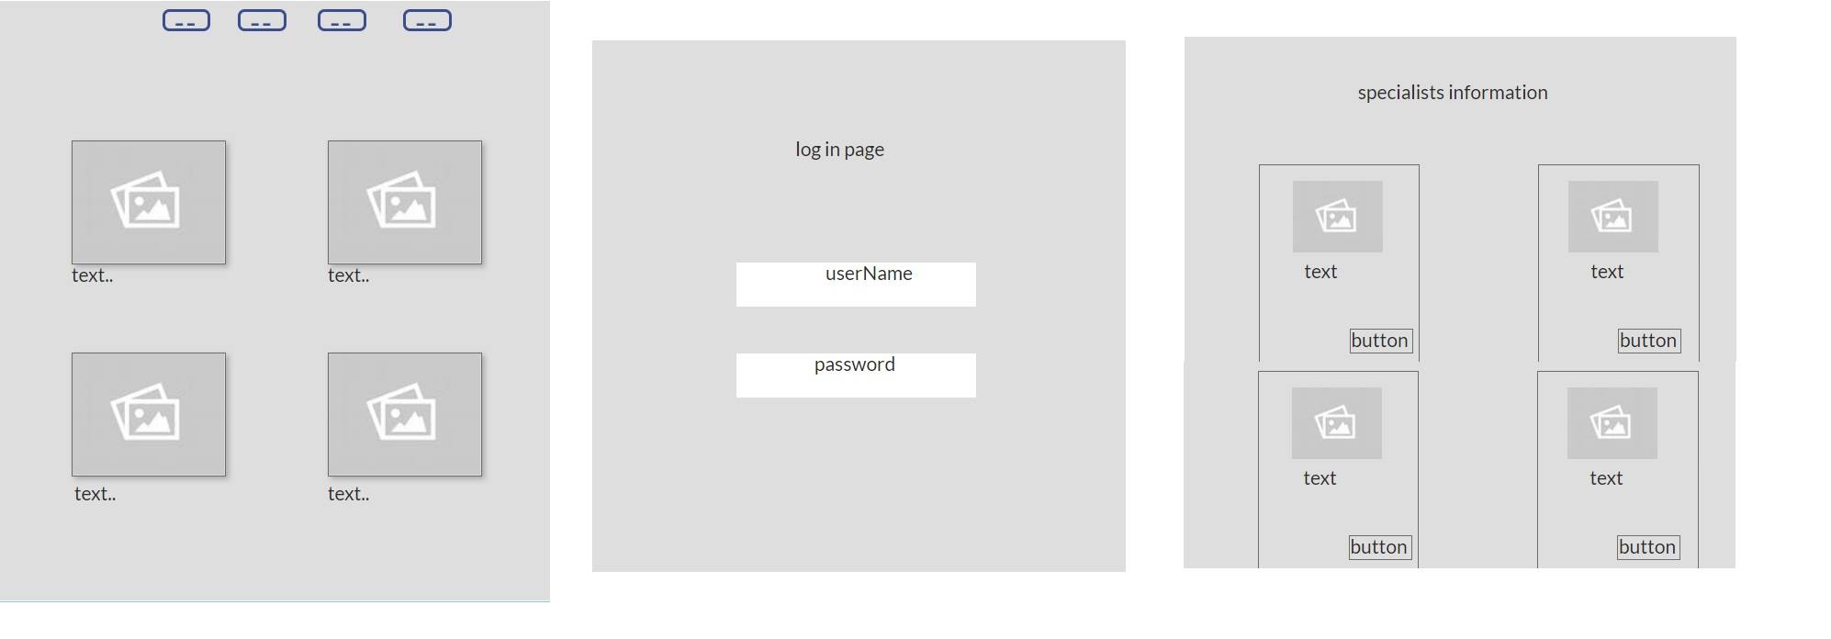
Wireframe

Slide 5
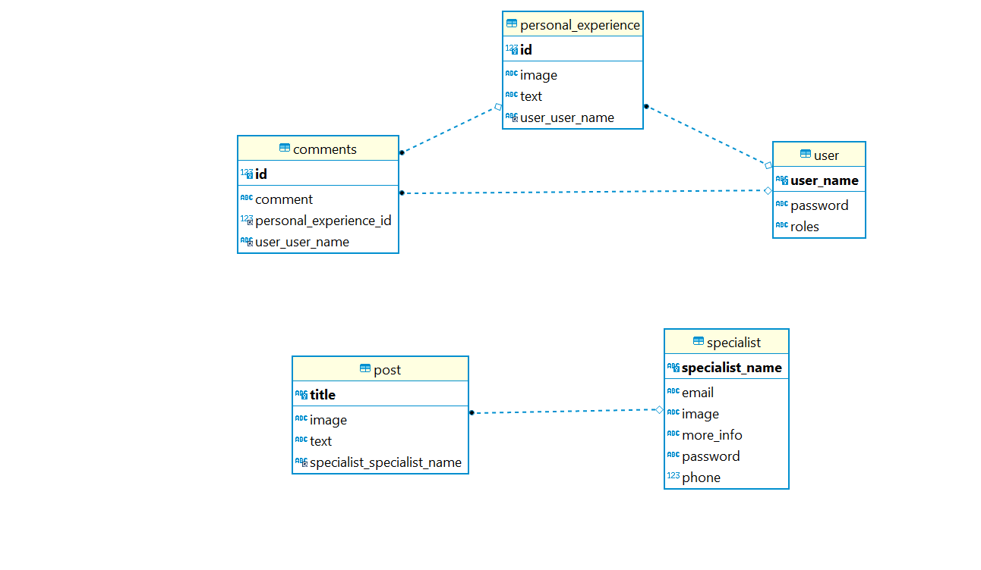
ERD

Slide 6
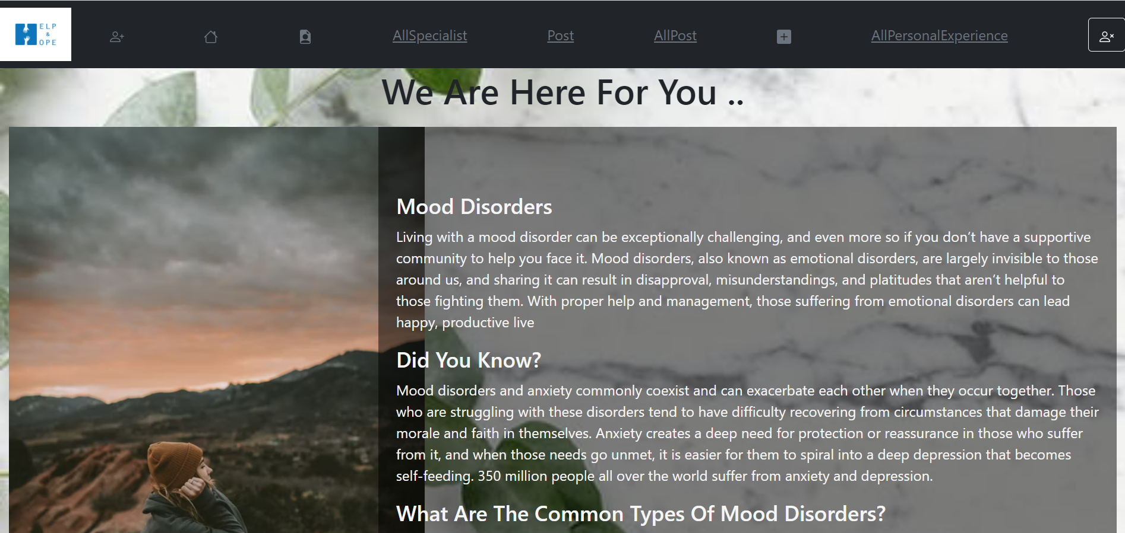
Demo of the project​
HOME PAGE

Slide 7
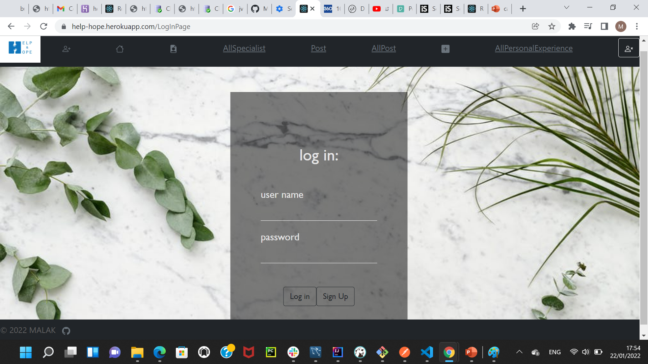
Demo of the project​
LOGIN PAGE

Slide 8
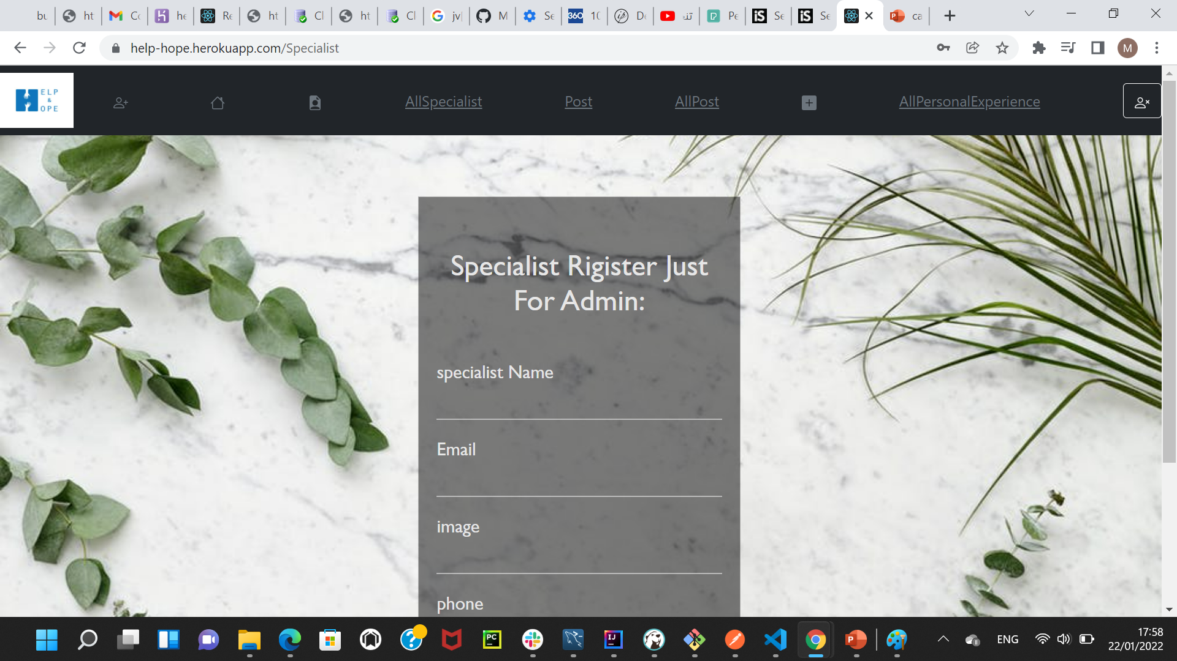
Demo of the project​
Specialist Register Just For Admin PAGE

Slide 9
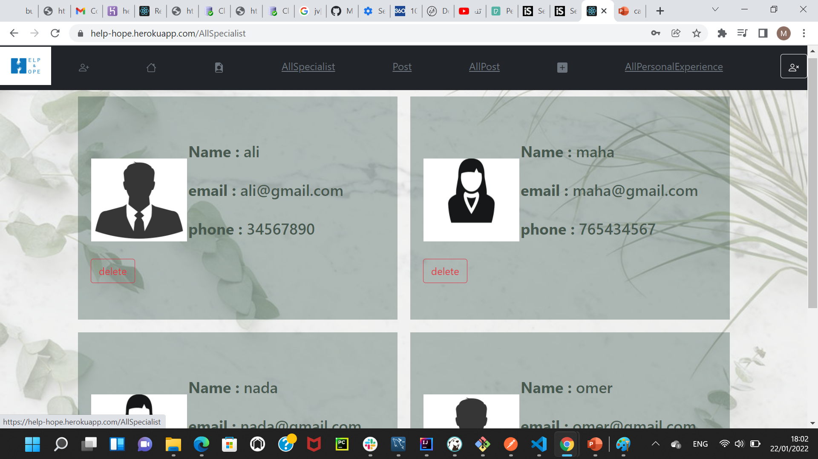
Demo of the project​
All Specialist PAGE​

Slide 10
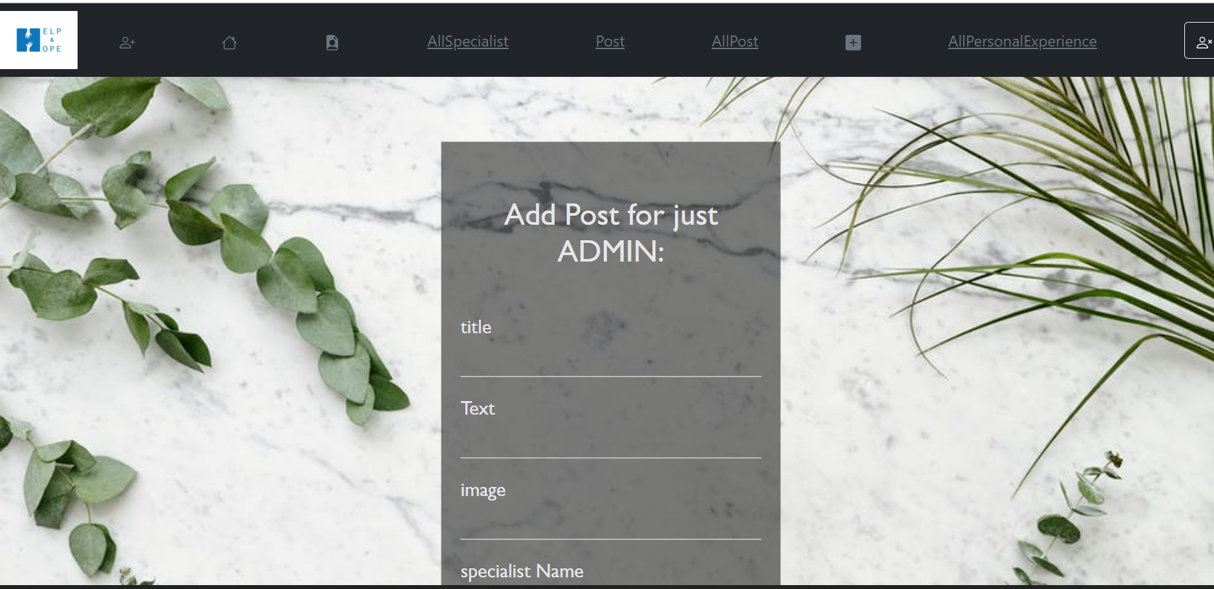
Demo of the project​
Add Post for just ADMIN PAGE​

Slide 11
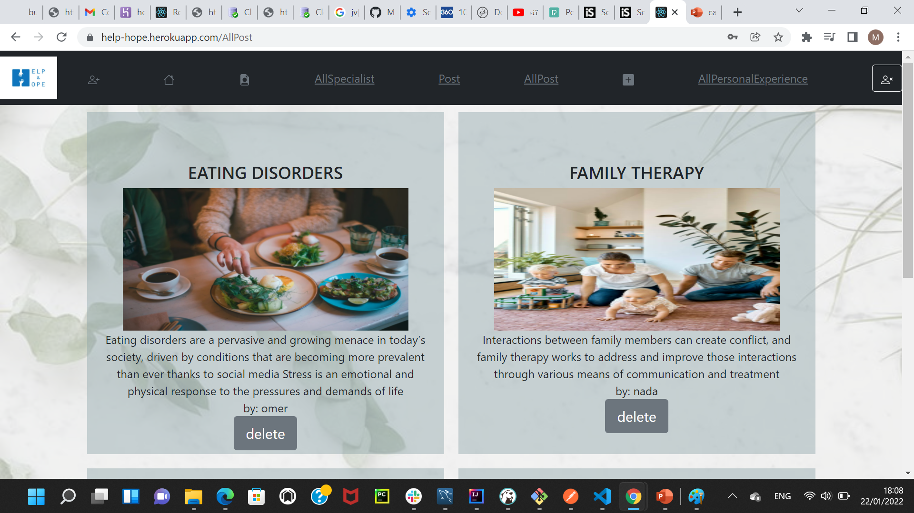
Demo of the project​
All Post PAGE​

Slide 12
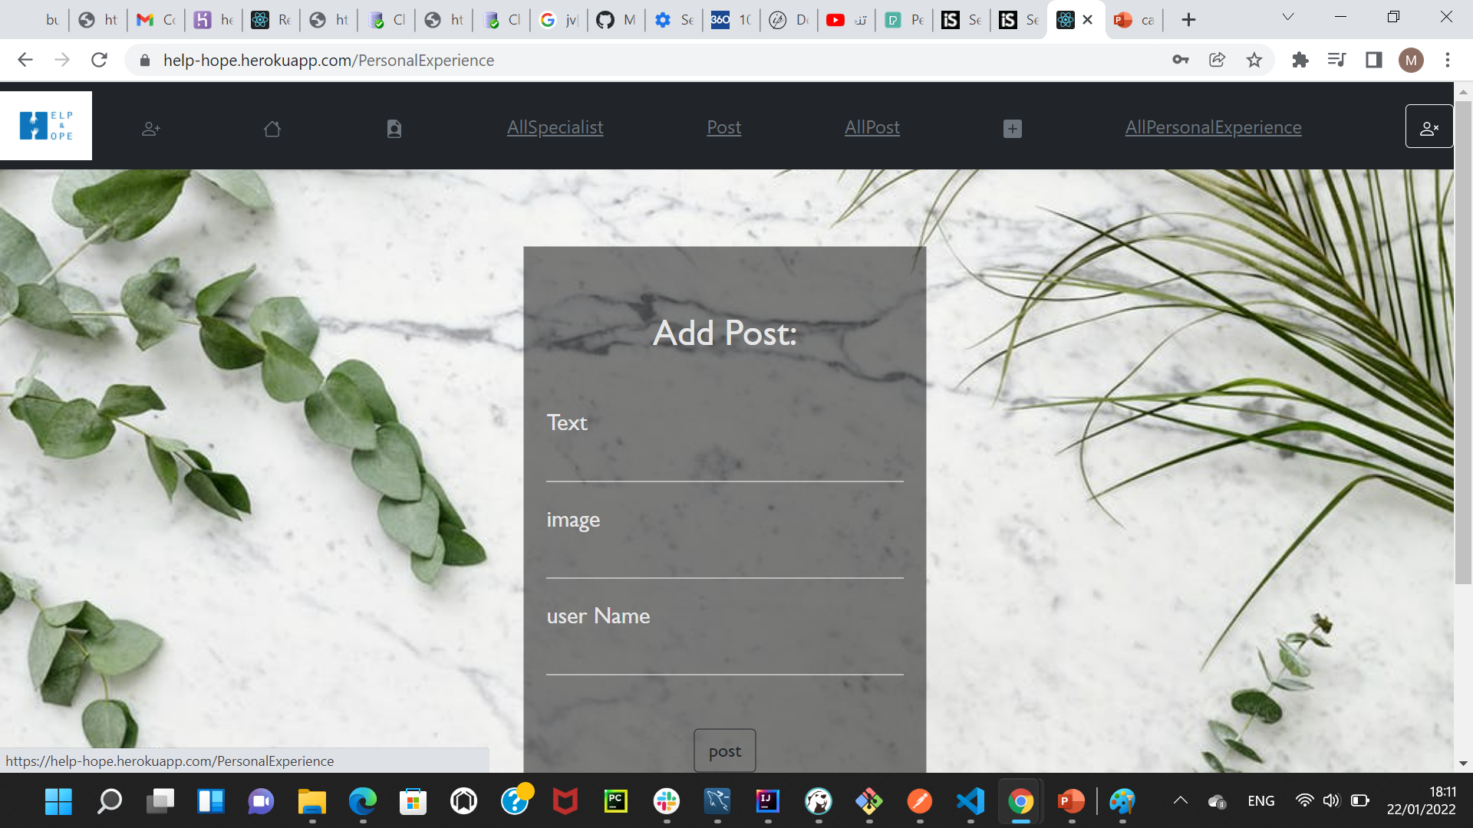
Demo of the project​
Add Personal Experience PAGE​

Slide 13
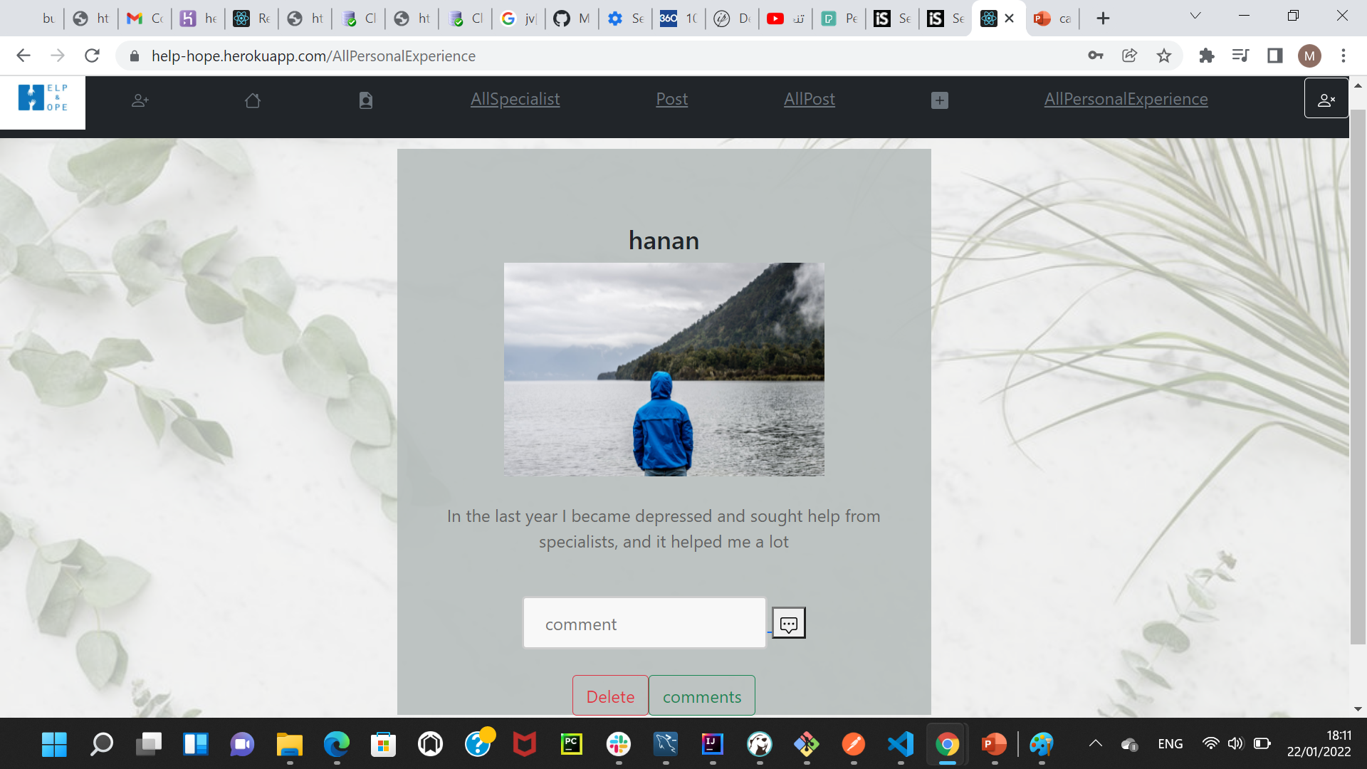
Demo of the project​
Personal Experience PAGE​

Slide 14
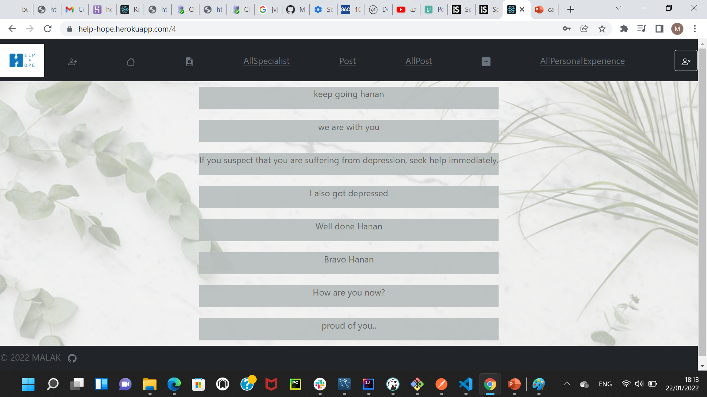
Demo of the project​
Comments PAGE​

Slide 15
Technologies used​
For Backend:
JAVA
Spring-boot
Database mySql
For front-end:
React
Connect the backend and frontend through the API

Slide 16
What was the most difficult part of the project​

Slide 17
What was your favorite part of the project​

Slide 18
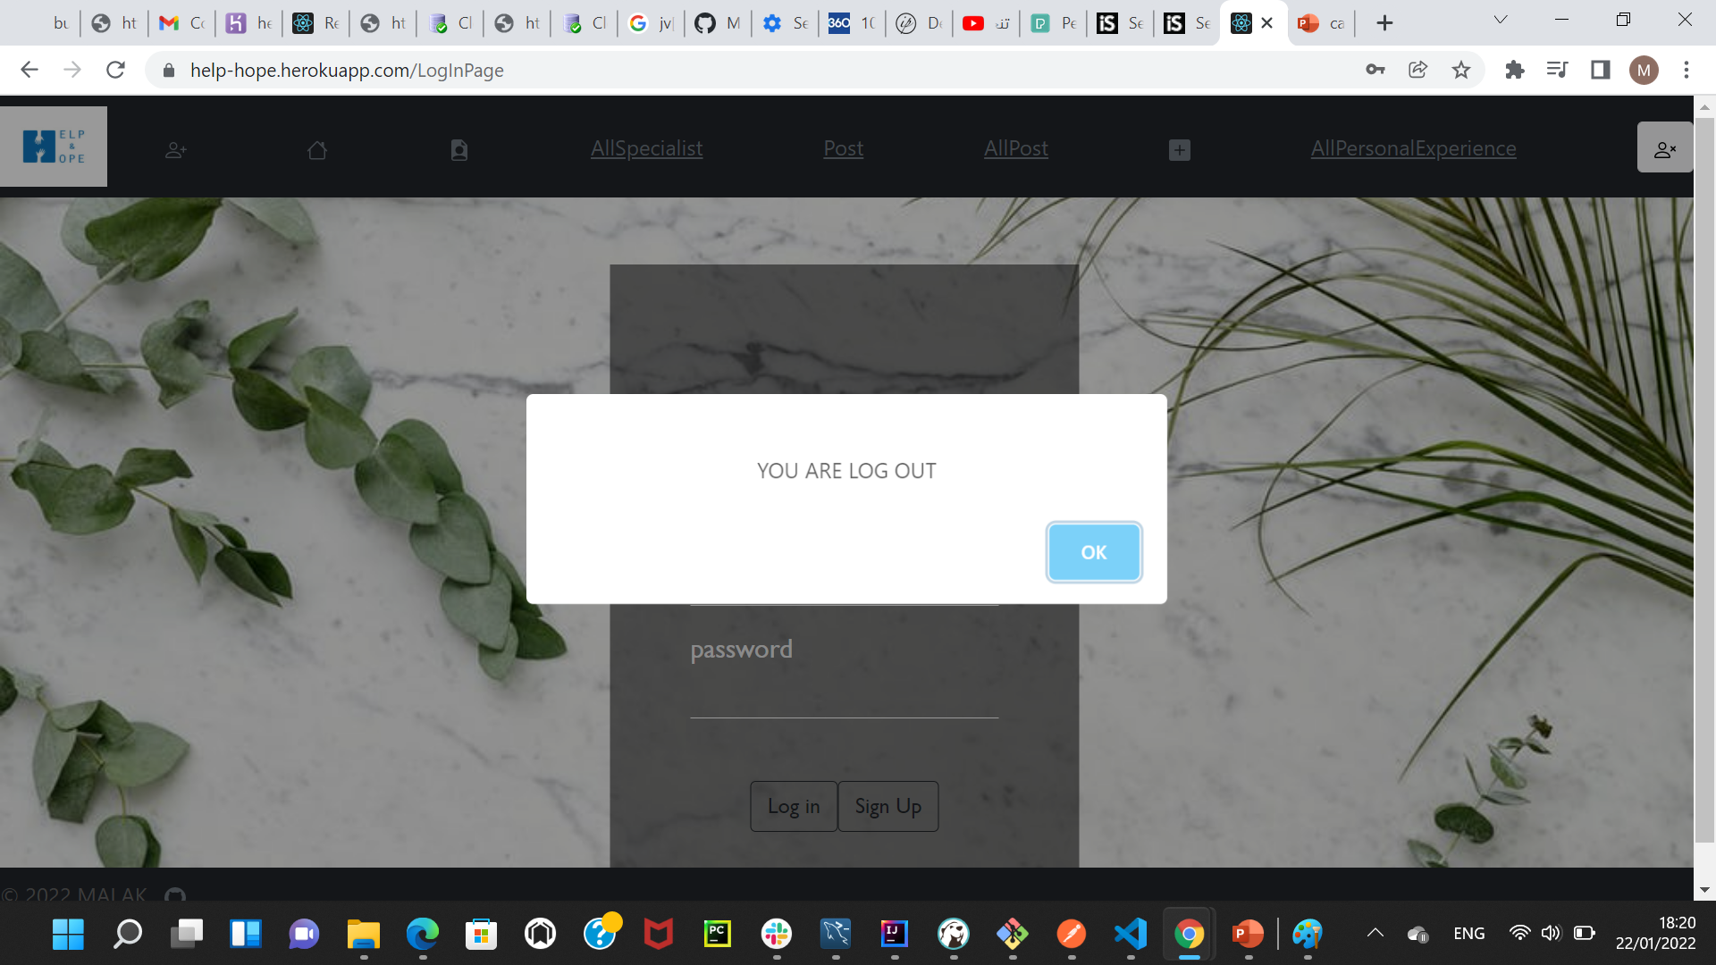
What are the new things you learned creating this application​
Swal :similar to Alert

Slide 19
Thank you

